Slide 1

Chapter 2 ::
Programming Language Syntax
Programming Language Pragmatics, Fourth Edition
Michael L. Scott
Copyright © 2016 Elsevier

Slide 2
Understanding the syntax
Unlike natural languages such as English or Chinese, computer languages
must be precise. Both their form(syntax) and meaning (semantics)must be specified
without ambiguity, so that both programmers and computers can tell what
a program is supposed to do.
digit → 0 | 1 | 2 | 3 | 4 | 5 | 6 | 7 | 8 | 9
non_zero_digit → 1 | 2 | 3 | 4 | 5 | 6 | 7 | 8 | 9
natural number → non zero digit digit *

Slide 3
RE and CFG
Different programming languages often provide features with very similar
semantics but very different syntax. It is generally much easier to learn a new language
if one is able to identify the common semantic ideas beneath the unfamiliar syntax.
In this chapter we focus on syntax: how we specify the structural rules
of a programming language, and how a compiler identifies the structure of a
given input program.
These two tasks—specifying syntax rules and figuring out how (and whether) a given program was built according to those rules—are distinct.
The first is of interest mainly to programmers, who want to write valid
programs. The second is of interest mainly to compilers, which need to analyze
those programs.
The first task relies on regular expressions and context-free grammars, which specify how to generate valid programs. The second task relies on scanners and parsers, which recognize program structure.

Slide 4
Tokens and Regular Expressions
Tokens are the basic building blocks of programs—the shortest strings of characters with individual meaning. Tokens come in many kinds, including keywords, identifiers, symbols, and constants of various types.
To specify tokens, we use the notation of regular expressions.

Slide 5
Regular Expressions
A regular expression is one of the following:
  A character
  The empty string, denoted by ε
  Two regular expressions concatenated
  Two regular expressions separated by | (i.e., or)
  A regular expression followed by the Kleene star
* (concatenation of zero or more strings)

Slide 6
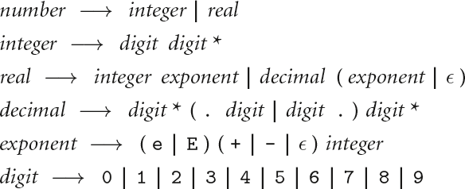

Regular Expressions
Numerical constants accepted by a simple hand-held calculator:

Slide 7
Context-Free Grammars
The notation for context-free grammars (CFG) is sometimes called Backus-Naur Form (BNF)
A CFG consists of
  A set of terminals T
  A set of non-terminals N
  A start symbol S (a non-terminal)
  A set of productions

Slide 8
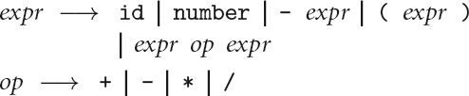
Context-Free Grammars
Expression grammar with precedence and associativity

Slide 9
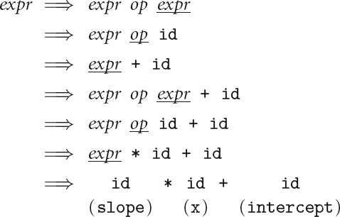
Context-Free Grammars
In this grammar, generate the string
"slope * x + intercept"

Slide 10
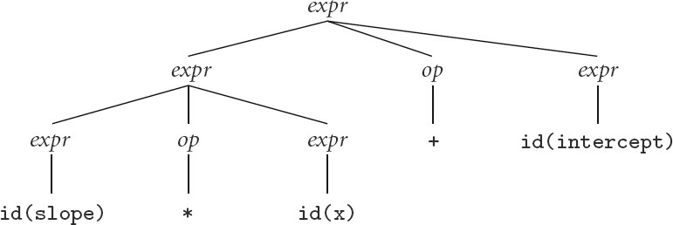
Context-Free Grammars
Parse tree for expression grammar for
"slope * x + intercept"

Slide 11
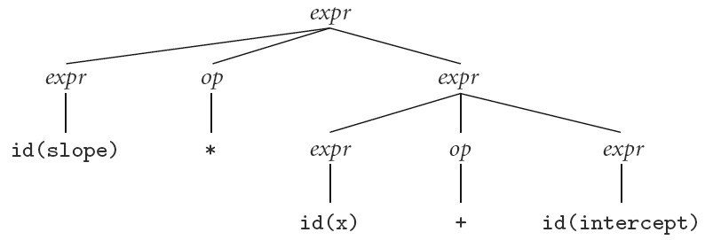
Context-Free Grammars
Alternate (Incorrect) Parse tree for
"slope * x + intercept"
Our grammar is ambiguous

Slide 12
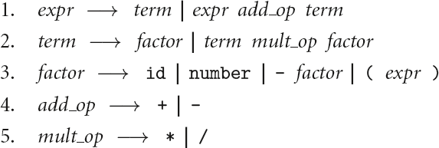
Context-Free Grammars
A better version because it is unambiguous and captures precedence

Slide 13
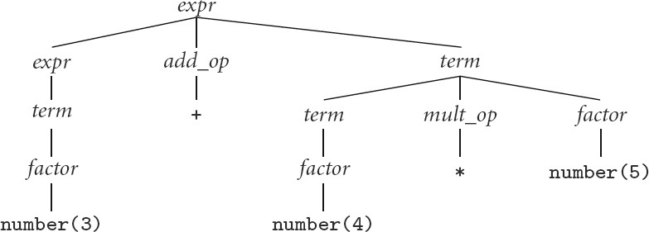
Context-Free Grammars
Parse tree for expression grammar (with left associativity) for 3 + 4 * 5

Slide 14
Scanning
Recall scanner is responsible for
  tokenizing source
  removing comments
  (often) dealing with pragmas (i.e., significant comments)
  saving text of identifiers, numbers, strings
  saving source locations (file, line, column) for error messages

Slide 15
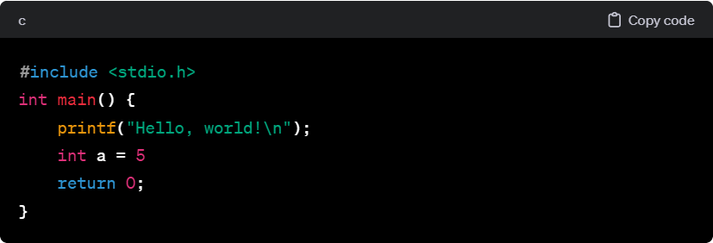
Scanning

Slide 16
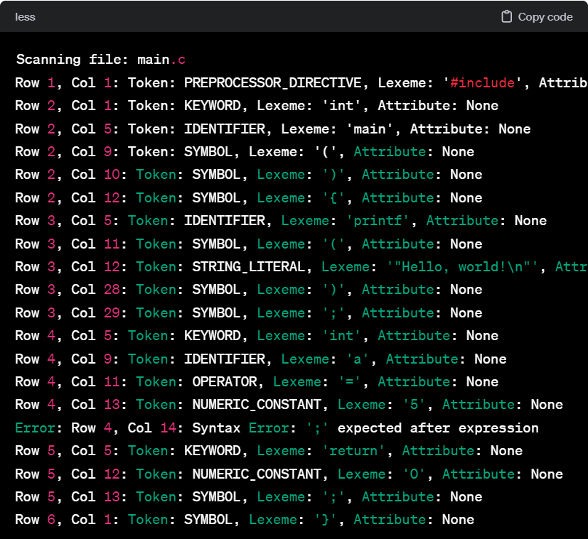
Scanning

Slide 17
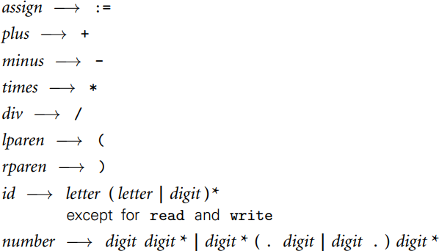
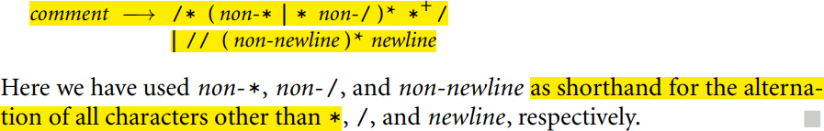
Scanning

Slide 18
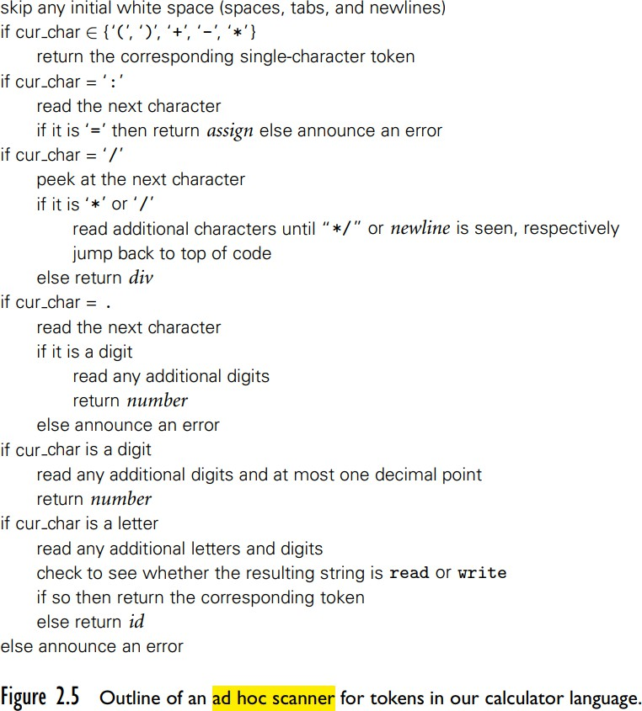
Scanning

Slide 19
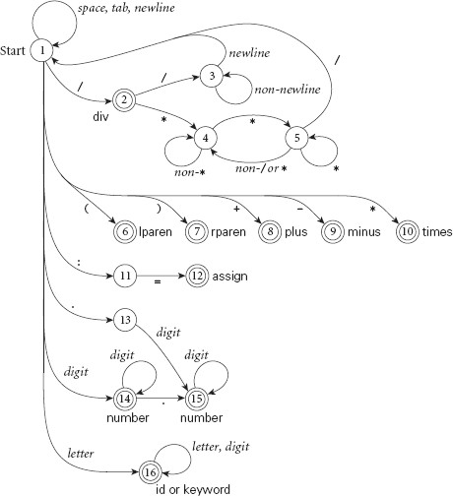
Scanning
Pictorial representation of a scanner for calculator tokens, in the form of a finite automaton

Slide 20
Scanning
This is a deterministic finite automaton (DFA)
A DFA is to represent a finite set of states and transitions. It is a type of finite state machine that accepts or rejects finite strings of symbols and produces a unique automaton for each input string.
  Lex, scangen, etc. build these things automatically from a set of regular expressions
  Specifically, they construct a machine that accepts the language
identifier | int const
| real const | comment | symbol

Slide 21
Scanning
We run the machine over and over to get one token after another
  Nearly universal rule:
    always take the longest possible token from the input
    thus foobar is foobar and never f or foo or foob
    more to the point, 3.14159 is a real const and never 3, ., and 14159
Regular expressions "generate" a regular language; DFAs "recognize" it
Core: build a DFA for scanner

Slide 22
How to build the DFA?
RE->NFA->DFA
An NFA, or Non-deterministic Finite Automaton, is a conceptual model used in computer science, particularly in automata theory and formal language theory, to represent and understand the behavior of systems with finite numbers of states.
there may be more than one transition out of a given state labeled by a given character, and
there may be so-called epsilon transitions: arrows labeled by the empty string symbol.
The NFA is said to accept an input string (token) if there exists a path from the
start state to a final state whose non-epsilon transitions are labeled, in order, by the characters of the token.

Slide 23
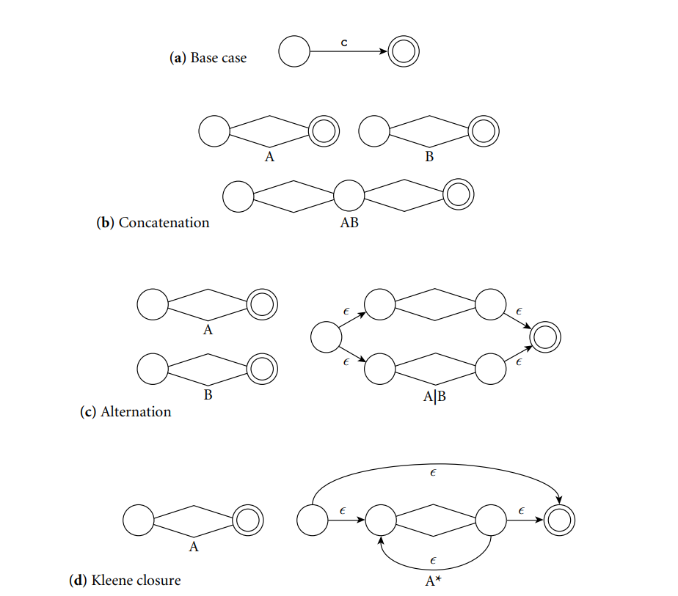
From a Regular Expression to an NFA

Slide 24
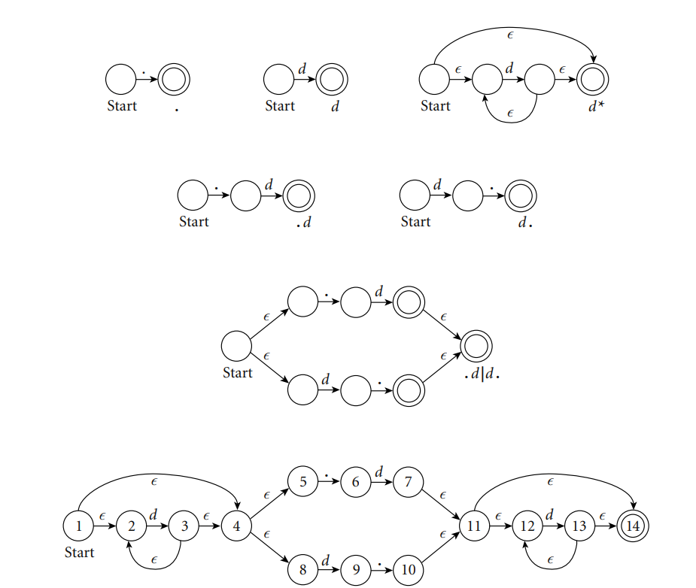
From RE to NFA:
Construction of an NFA equivalent to the regular expression d *( .d | d. ) d *

Slide 25
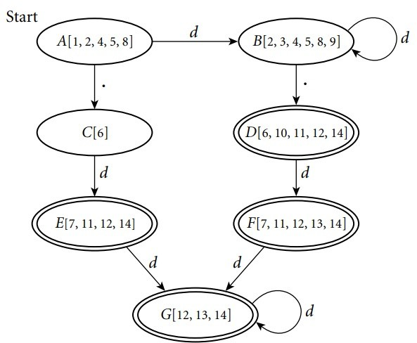
From NFA to DFA:

Slide 26
Scanning
Scanners tend to be built three ways
  ad-hoc
  semi-mechanical pure DFA
(usually realized as nested case statements)
  table-driven DFA
Ad-hoc generally yields the fastest, most compact code by doing lots of special- purpose things, though good automatically- generated scanners come very close

Slide 27
Scanning
Writing a pure DFA as a set of nested case statements is a surprisingly useful programming technique
Table-driven DFA is what lex and scangen produce
  lex (flex) in the form of C code
  scangen in the form of numeric tables and a separate driver (for details see Figure 2.12)

Slide 28
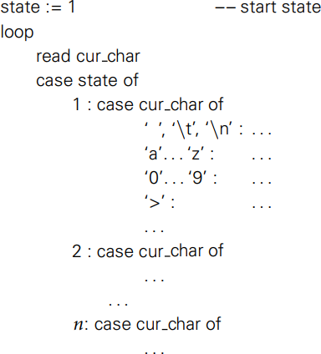
nested case statements

Slide 29
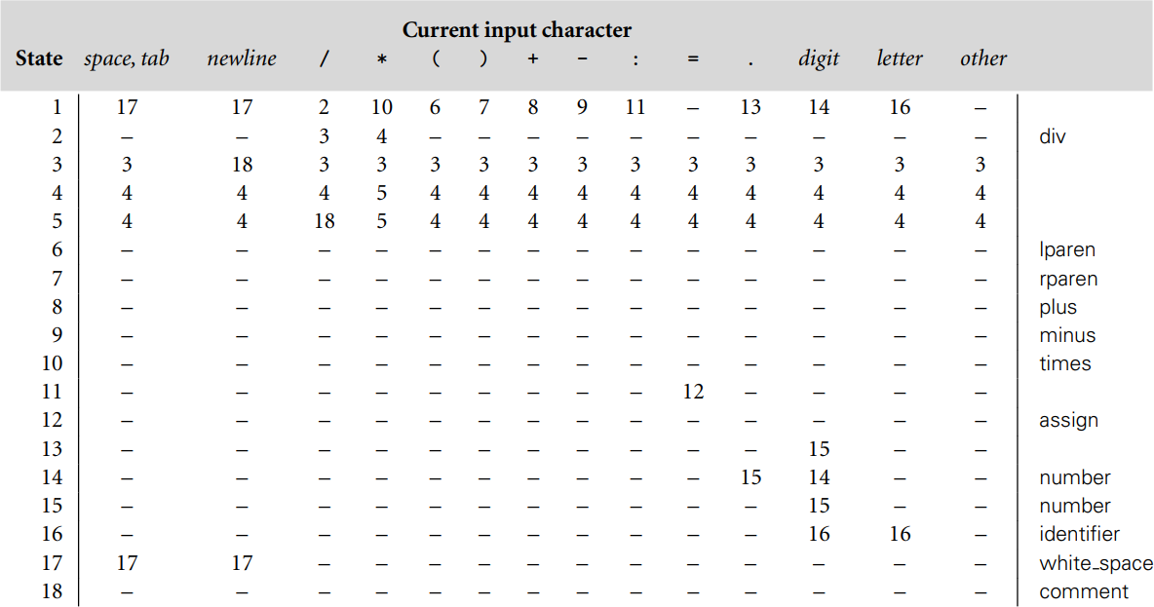
Table Driven

Slide 30
Scanning
Note that the rule about longest-possible tokens means you return only when the next character can't be used to continue the current token
  the next character will generally need to be saved for the next token
In some cases, you may need to peek at more than one character of look-ahead in order to know whether to proceed
  In Pascal, for example, when you have a 3 and you a see a dot
    do you proceed (in hopes of getting 3.14)? or
    do you stop (in fear of getting 3..5)?

